Slide 1
Project Scope Management

Slide 2
Contents
Scope Management
Product Vs Project Scope
Project Charter (Integration Management KA)
Project Requirements
Scope Statement
WBS & WBS Dictionary
Scope Verification
Scope Control

Slide 3
Project Scope Management
Scope refers to all the work involved in creating the products of the project and the processes used to create them.
A deliverable is a product produced as part of a project, such as hardware or software, planning documents, or meeting minutes.

Slide 4
Project Scope Management
Scope management is the process of defining what work is required and then making sure all of that work and only that work is done. It is primarily concerned with what is and is not included in the project.
Scope must be defined, clear, and formally approved before work starts.

Slide 5
Product Vs Project Scope
Product Scope:
  The features and the functions that characterize a product service or a result.
  For Example – A school building with 10 class rooms, a play ground, a cafeteria, a library, a staff room and 3 bath rooms.
  A mobile phone with the ability receive and send sms and phone calls with support for GPS.
Project Scope:
  The work that needs to be accomplished to deliver the product service, or result with the specified features and functions.
  For Example - Working out the cost estimate, time schedule, resource requirements of the school building and its construction to meet the product features and functions.
  Design and manufacturing of the mobile phone with all the associated management activities to meet the product features and functions.

Slide 6
Product Vs Project Scope
Completion of the project is measured against the project management plan, project scope statement, WBS and the WBS dictionary.
Completion of the product scope is measured against the product requirements (features and functions).

Slide 7
Project Charter (Integration Management Knowledge Area)
Definition
  The project charter is a document that formally authorizes a project.
  A project manager is identified and his authority is defined.
  It is an authorization or go ahead signaling document that allows an organization to commit its resources to the project that has been selected after need assessment and/or feasibility study among a number of alternatives.
  The establishment of terms of reference/project charter will define the scope of the project. It defines the parameters within which the project must be delivered.
Notes:
It is a summary project proposal to secure approval for the project goals and terms.
It is an authorization or go ahead signaling document that allows an organization to commit its resources to the project that has been selected after need assessment and/or feasibility study among a number of alternatives.

Slide 8
Project Charter (Integration Management Knowledge Area)
Contents
  Identify the project vision and objectives
  Define the high level scope of the project
  List all the critical project deliverables
  State the customers and project stake holders
  List the key roles and their responsibilities
  Create an organizational structure for the project
  Business Case (Need)
  List any risk, issues and assumptions

Slide 9
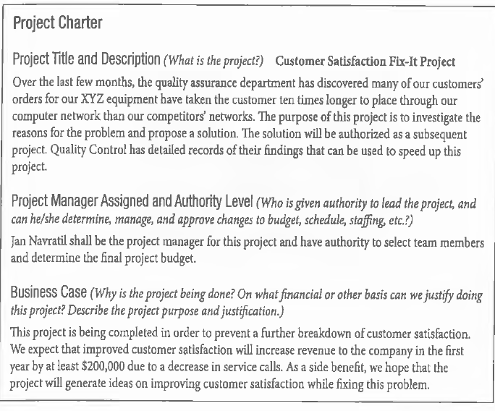

Slide 10
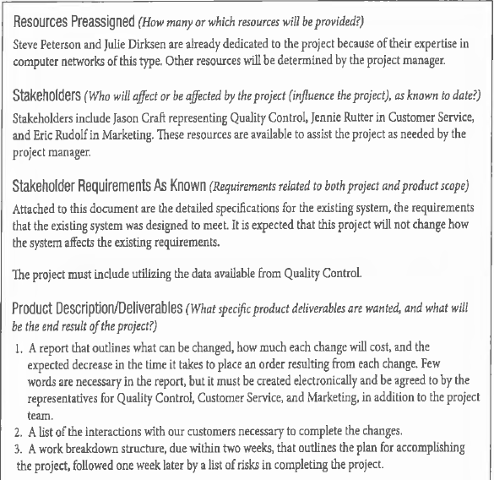

Slide 11
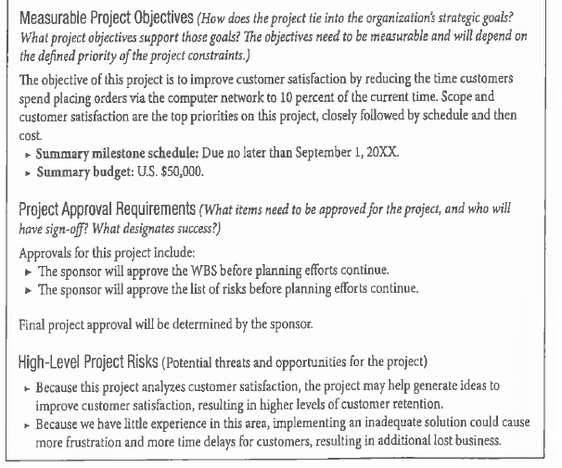

Slide 12
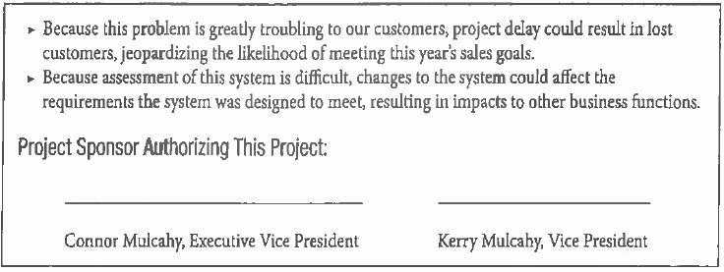

Slide 13
Project Scope Management Processes
Requirements Collection
Scope Definition
Create Work Break Down Structure (WBS)
Scope Verification
Scope Control

Slide 14
Requirements Collection
It is the process of defining and documenting stakeholders’ needs to meet the project objectives.
Requirements include the quantified and documented needs and expectations of the sponsor, customer, and other stakeholders.
Requirements ultimately become the foundation of the WBS. Cost, schedule, and quality planning are all built upon these requirements.
Development begins with an analysis of the information contained in the project charter and the stake holder register.
These may include project requirements such as project management requirements, business requirements and product requirements such as technical requirements, security requirements and performance requirements.
Notes:
A Stakeholder Register is a project management document, which contains the information about all project stakeholders. It identifies and lists the people, groups and organizations impacted by the project. In this register you can find every detail about the stakeholders including their names, titles, role, interests, power, requirements, expectations, and influence to affect any project objective and many more things.
It is very important for you to create the stakeholder register as early as possible if you want to complete your project with minimum hassle. Once you create the stakeholder register and list all identified stakeholders in it, you can easily draft the strategy to manage them.

Slide 15
Requirements Collection (Examples)
Requirements may include:
  requests about how the work is managed –
  Construction of a tunnel under an existing road way without stopping traffic.
  Excavation/Removal of rocks without the ability to conduct blasting (Islamabad local bylaws)
  Capabilities that stake holders would like to see in their projects – Provision of landing strips on motorway to take jet aircraft landing and takeoff loads.
  Quality requirements – Bricks should be watered before the commencement of plasterwork.
  Health & Safety Requirements – The project shall be completed with zero fatalities and lost time injuries.
  Company’s Business process – monthly reporting of project progress using S-curves.
Notes:
The S-Curve is a visual representation of the
project path. Managers use it to assess progress
against estimates (schedule and/or budget)
and course-correct accordingly.

Slide 16
Requirements Collection (Tools & Techniques)
1. Interviews (all project stakeholders involved)
2. Focus groups (involves a specific group of stakeholders or SME’s)
3. Group decision making techniques
4. Questionnaires and surveys
5. Observations
6. Prototypes etc.

Slide 17
Requirements Collection (Outcome)
Some of the outcomes of the requirements collection include:
  Requirements Documentation
    It describes how individual requirements meet the business need for the project. A requirements document may range from a simple document listing all the requirements to detailed form containing executive summary, detailed descriptions etc.
  Requirements Management Plan
    It documents how requirements will be analyzed, documented and managed throughout the project.

Slide 18
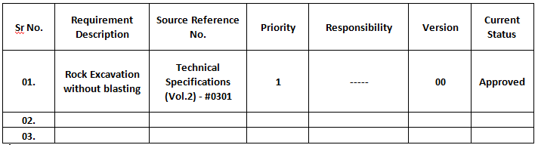
Requirements Collection (Outcome)
  Requirements traceability matrix
    It is a table that links requirements to their origin and traces them through out the project life cycle. It provides a means to track requirements throughout the project life cycle, helping to ensure that requirements approved in the requirements documentation are delivered at the end of the project.

Slide 19
Scope Definition
It is the process which is primarily concerned with what is and is not included in the project and its deliverables.
This process uses the requirements documentation created in the requirement collection process, the project charter, and any information about project risks, assumptions, and constraints to define the project and product scope.

Slide 20
Scope Definition (Outcome)
Project Scope Statement
  The project scope statement describes, in detail, the project’s deliverables and the work required to create those deliverables.
  The project scope statement also provides a common understanding of the project scope among project stakeholders.

Slide 21
Scope Definition (Outcomes)
Project Scope Statement
  It enables the project team to perform more detailed planning, guides the project team’s work during execution, and provides the baseline for evaluating whether requests for changes or additional work are contained within or outside the project’s boundaries.
  Although Project Scope Statement contents vary, it should at a minimum include a Project Scope description, Product user acceptance criteria and detailed information on all project deliverables.

Slide 22
Scope Definition (Outcomes)
The detailed project scope statement includes either directly or by reference to other documents:
  Product scope description
  Product acceptance criteria
  Project deliverables
  Project exclusions
  Project constraints
  Project risks/assumptions

Slide 23
Create Work Break Down Structure (WBS) / Top Down Planning
It is the process of subdividing project deliverables and project work in to smaller more manageable components.
The WBS represents all product and project work.
A WBS is a deliverable-oriented grouping of project components that organizes and defines the total scope of the project. Work not included in the WBS is outside the scope of the project.
Each descending level of the WBS represents an increased detailed definition of the project work.

Slide 24
Work Breakdown Structure
A WBS is a graphical display of the project that shows the division of work in a multilevel system.
The number of levels in a WBS will vary depending upon the size and the complexity of the project and as a rule of thumb 4 to 6 levels are considered sufficient. It is not necessary to divide each root at the second level in to equal sub-levels.
Although the project manager is free to determine the number of levels in the WBS based on the complexity of the project, the highest level of the WBS, level one, is considered the project itself.

Slide 25
Work Breakdown Structure
This is followed by the deliverables, which might be followed by more deliverables followed by activities and so on. Each of these breakouts is called a level in the WBS with the project itself as level one, the deliverables as level two, and so on.
The PM starts the process of developing the WBS by identifying major areas of the project and the project team members define the work to be performed in more details in those specific areas.
The process of subdivision and decomposition into work packages continues until the lowest level WBS components are defined.
Notes:
The concept of a work package can be a difficult one for some people. In project management, a work package is defined as the effort required to produce a deliverable within a project. This effort may be a single task or it could be several related tasks. Many people think of a work package as a sort of “mini project” within a larger project. When all of the individual work packages within a larger project are completed, the overall project is done.
Each step within a work package includes the steps needed for completion along with a deadline for each step. This helps the project manager ensure the overall project remains on schedule. The benefit of using work packages is that it allows many different pieces of the overall project to be worked on at the same time, usually by different groups of people. The team assigned to each work package completes their tasks and then the individual packages all merge together seamlessly at the end.

Slide 26
Work Breakdown Structure
A work package may be a collection of related tasks/activities or a single activity in itself.
A work package must be defined in sufficient detail so that work can be measured, budgeted, scheduled, and controlled.
Decomposition of the total project work into work packages generally involves the following activities:
  Identifying and analyzing the deliverables and related work,
  Structuring and organizing the WBS,
  Decomposing the upper WBS levels into lower level detailed components,
  Developing and assigning identification codes to the WBS components, and
  Verifying that the degree of decomposition of the work is necessary and sufficient.

Slide 27
Work Breakdown Structure
A work Package may look something like this:
  Work Package – Concrete Floor Slab
    Excavate
    Install Edge forms
    Install under slab fill
    Install the reinforcing
    Place/pour the concrete
    Finishing and Curing
    Stripping the forms

Slide 28
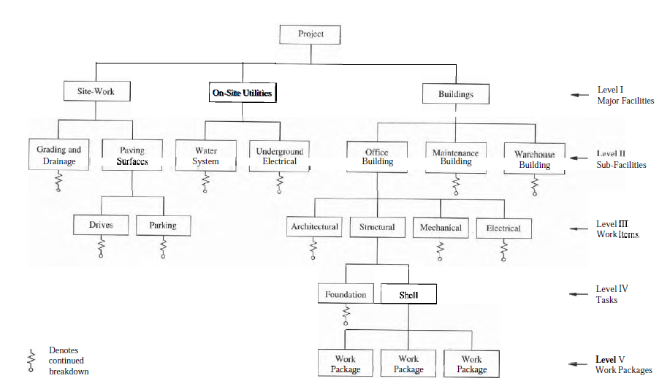

Deliverable oriented Decomposition

Slide 29
Numbering/Coding System of WBS
Each element at each level of the WBS should be assigned a unique identifier according to the Guide to the PMBOK. This unique identifier is typically a number, and it’s used to track the cost of the WBS element. These numbers are usually associated with the corporation’s financial system chart of accounts. The numbering scheme for the requirements definition branch of the WBS might look something like this:

Slide 30
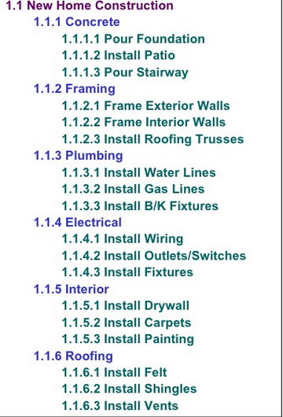
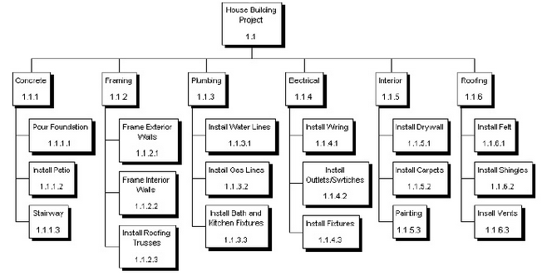
Numbering/Coding System of WBS

Slide 31
Work Breakdown Structure
There is no right way of constructing a WBS. Defining 100% of the project scope is the main Goal.
Updates to a WBS are possible as more information regarding the project scope becomes available or if there is a significant change in the project scope/deliverables.
For some deliverables decomposition at a given time may not be possible and will become possible only when the requisite information becomes available. This is called rolling wave planning.
The total of the work at the lowest levels must roll up to the higher levels so that nothing is left out and no extra work is completed. This is sometimes called the 100% rule.

Slide 32
WBS Dictionary
This contains a description of the work package level and details regarding the activities within the work package. Information such as costs, budgets, resource assignments, and activity descriptions would be found in the WBS dictionary.
A better understanding can be achieved by considering WBS as a table of contents for the project in an organized fashion (chapters and Sub-Chapters) and WBS DICTIONARY as the book itself.

Slide 33
WBS Dictionary
Some of the information in the WBS dictionary includes:
  Description of work (A narrative)
  Responsible organization
  List of schedule milestones
  Associated schedule activities
  Resources required
  Cost estimates
  Quality requirements
  Contract information

Slide 34
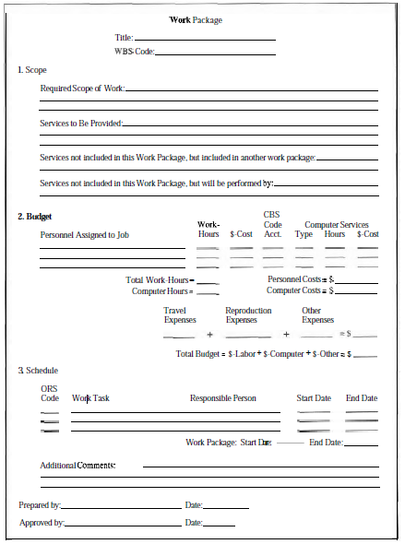
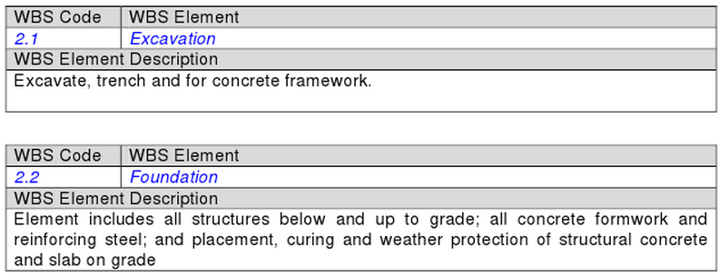
Examples of a WBS Dictionary

Slide 35
Create Work Break Down Structure (Outcome)
Scope Baseline
  It is a component of the project management plan and an output of create WBS process. This includes the project Scope Statement, the WBS and WBS Dictionary, and these items become the baseline against which all changes to the project will be managed and measured. Once these items have been approved, agreed-upon and baselined, formal change management for the project begins.

Slide 36
Create Work Break Down Structure (Outcome)
Scope Baseline
  It includes:
    Project scope statement
      The project scope statement includes the product scope description, and the project deliverables, and defines the product user acceptance criteria.
    WBS
      The WBS defines each deliverable and the decomposition of the deliverables into work packages.
    WBS dictionary
      The WBS dictionary has a detailed description of work and technical documentation for each WBS element.

Slide 37
Verify Scope
It is the process of formalizing acceptance of the completed project deliverables.
Verifying deliverables includes reviewing deliverables with the customer or sponsor to ensure that they are completed satisfactorily and obtaining formal acceptance of deliverables by the customer or sponsor.
Scope verification differs from quality control in that scope verification is primarily concerned with acceptance of the deliverables, while quality control is primarily concerned with correctness of the deliverables and meeting the quality requirements specified for the deliverables. Quality control is generally performed before scope verification, but these two processes can be performed in parallel.

Slide 38
Verify Scope
The quality control process is executed before scope verification process therefore generating validated deliverables that have been checked for correctness.
Examples:
  Monthly progress payments of the contractor for the actual work executed in the field are first verified by the client’s representative (Resident Project Engineer) and the Project Manager (Contractors) before forwarding to the client for payment. Such verification includes on-site measurement of work in place.

Slide 39
Verify Scope
Examples:
  When a project nears completion two inspections are carried out to verify scope of work, the pre-final and final inspection.
  At the completion of the project the owner’s representatives and the project manager (Contractor’s) make a punch list that entails all the works needing correction which have not been found in accordance with the requirements of the contract documents. This is done after the pre-final inspection.
  After the corrections have been made, a final inspection is carried out to ensure satisfactory completion of the project before issuing the project completion certificate and making final payment to the contractor.

Slide 40
Scope Verification (Outcome)
The outcomes of Scope Verification are:
  Accepted Deliverables
    Those deliverables which meet the acceptance criteria and are formally signed off and approved by the customer or sponsor.
  Change Requests
    Those deliverables which are not formally accepted are documented along with reasons for non-acceptance. They may require a change request for defect repair.
  Project Document updates
    It includes updating any documents that define the product or report status on product completion.

Slide 41
Scope Control
It is the process of monitoring the status of the project and managing changes to the scope baseline.

Slide 42
Scope Control
Some of the outcomes of the Scope Control include:
  Work Performance Measurements
  Change Requests
  Project Management Plan updates
  Project Document updates

Slide 43
Thank You

